Slide 1
WEB APPLICATION DEVELOPMENT TRAINING
INTRODUCTION TO JAVASCRIPT
WEEK 4 DAY 1
22/05/2017

Slide 2
Javascript Events and Inline Placement
HTML events are "things" that happen to HTML elements, It can be something the browser does, or something a user does.
Example is: HTML button was clicked
When events happen, you may want to do something.
JavaScript lets you execute code when events are detected.
When JavaScript is used in HTML pages, JavaScript can "react" on these events.
Syntax : <HTML Tag some-event="some JavaScript">

Slide 3
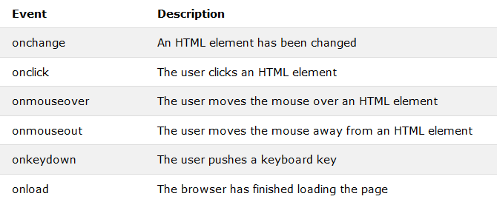
JS Events

Slide 4
JavaScript Popup Boxes
JavaScript has three kind of popup boxes: Alert box, Confirm box, and Prompt box.
Alert Box: often used if you want to make sure information comes through to the user.
When an alert box pops up, the user will have to click "OK" to proceed.
Syntax: window.alert("sometext");
Exercise: Using JS alert box, add a welcome message to your website
Notes:
The window.alert box can be written without the window prefix
Ponder: GTB e-banking platform alert

Slide 5
JavaScript Popup Boxes
Confirm Box: often used if you want the user to verify or accept something.
When a confirm box pops up, the user will have to click either "OK" or "Cancel" to proceed.
If the user clicks "OK", the box returns true. If the user clicks "Cancel", the box returns false.
Syntax: window.confirm("sometext");
Notes:
The window.confirm() method can be written without the window prefix.
Usually used to confirm deletion

Slide 6
JavaScript Popup Boxes
A prompt box is often used if you want the user to input a value before entering a page.
When a prompt box pops up, the user will have to click either "OK" or "Cancel" to proceed after entering an input value.
If the user clicks "OK" the box returns the input value. If the user clicks "Cancel" the box returns null.
Syntax: window.prompt("sometext","defaultText");
Notes:
The window.prompt() method can be written without the window prefix.

Slide 7
Exercise
Based on your understanding of Javascript variables and the pop up boxes, get the name of a visitor to your website and greet him/her mentioning their names
Hint : prompt boxes
Notes:
<script type="text/javascript">
var name = window.prompt("Please Enter Your Name");
alert(name +" Thank you for visiting my site");
</script>

Slide 8

Assignments
Create a button using HTML button tag with the value “Add 6 and 12”, write an inline javascript such that when the button is clicked, 18 is displayed in an alert box
Create a HTML input type of button, and label it “Check Result” when this button is clicked, display a prompt box and allow the user to enter their fullname. Use console.log() to write this fullname into the console.

Slide 9
Other Things you can do with JS - HTML DOMS
Change the content of HTML elements
Change the style (CSS) of HTML elements
React to HTML DOM events
Add and delete HTML elements

Slide 10
The DOM and HTML Element Selector
DOM Stands for Document Object Model
Created when a web page is loaded, it breaks the HTML tags down and shows the relationship among them (cascading, parent::child relationship)
This gives javascript the power to add dynamism into the webpage, such things as:
Select, change HTML elements, their attributes, CSS Styles etc in the page

Slide 11
The DOM and HTML Element Selector
All the HTML tags are treated as objects which has properties and methods and can respond to events.
The document object represents your web page and is the owner of all other objects.
If you want to access any element in an HTML page, you always start with accessing the document object.
document.method.property_of_the_element
Method represents what you can do on the object (action) while property represents what you can change about the object
The HTML tags (objects) on a webpage can be referenced (or picked) using four methods namely:

Slide 12
The DOM and HTML Element Selectors
  document.getElementById(id)
  document.getElementsByTagName(name)
  document.getElementsByClassName(name)
  document.getElementsByName(name)
After picking the HTML tags, you can change their properties using any of:
  element.innerHTML = new html content element.attribute = new value element.setAttribute(attribute, value) element.style.property = new style

Slide 13
QUIZ
Describe the attribute of interest in the following scenarios:
  To determine the height of an image
  To determine if an input box is a radio button or not
  To determine where a form will submit to
  To determine the label on a button
  To determine the class of a link
  To determine the inline CSS applied to an element
  To determine the path of an image
  To determine where a marquee scroll to
  To determine what a user types in an input field
  To determine if a link will open in a new window
  To determine what will be displayed if an image is missing

Slide 14
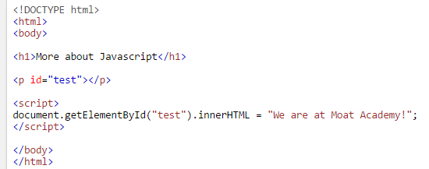
The getElementById Method
The getElementById Method: is the most common way to access an HTML element by using the id of the element.
Try This and see the notes for more exercise
Notes:
Exercise: You will notice that the display of innerHTMl for the p tag happened as the page fully loaded. Now, create an hyper link and attach the JS to an onclick event. PS: the user should not be redirected to a new page with the click

Slide 15
The getElementById()
The ID is a string which can be used to uniquely identify an element on a webpage.
It is an HTML attribute. There should only be one id value in a document
Id is case-sensitive

Slide 16
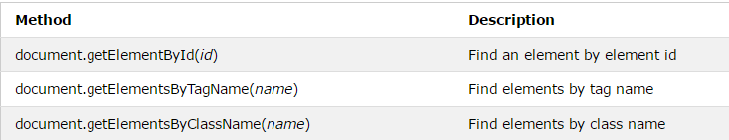
The DOM Methods
InnerHTML Property: useful for getting or replacing the content of HTML elements.
The innerHTML property can be used to get or change any HTML element especially those that do not have the “value” attribute, including <html> and <body>.

Slide 17
General Formula
Saying: Look for an element on this page that has id called id
After picking the element, ask: which of its attribute am I interested in?
To give the attribute a new value, use the equals to sign as shown below
document.getElementById(id).attribute = new value

Slide 18
Changing the Value of an Attribute
document.getElementById(id).attribute = new value
document.getElementById(“demo").style.color = "red";
Complete list of CSS Style Properties is found on: https://developer.mozilla.org/en-US/docs/Web/CSS/CSS_Properties_Reference

Slide 19
Assigning an attribute to a variable
X = document.getElementById(id).attribute

Slide 20
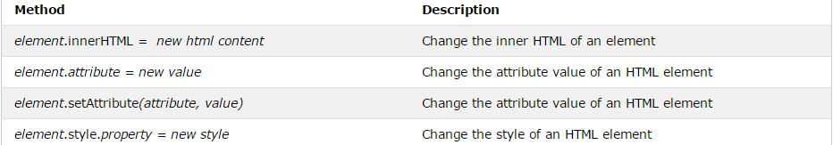
Changing HTML Properties

Slide 21
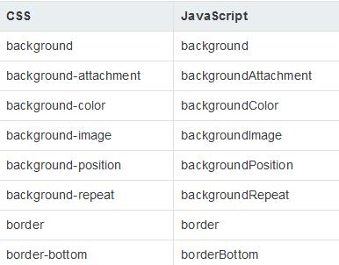
Changing the Value of an Attribute

Slide 22
Exercise 1
Step 1: Create a HTML document, place one of the images given to you on the page using the img tag.
Step 2: Using javascript statement, change the picture displayed and show, the second part of the image instead.
The JS code in step 2 above should be attached to a button click event.

Slide 23
Exercise 2
Modify the above code such that the image changes to another when the image is clicked.
The this keyword can be used to replace document.getElementById() when you are on the same element. See notes for example usage
Notes:
Subtlily introduce participants to this keyword
<img src=“new.jpg” onclick=“this.src=‘old.jpg’” id=‘image’/> rather than <img src=“new.jpg” onclick=“document.getElementBId(‘image’).src=‘old.jpg’” id=‘image’/>

Slide 24
DAY 3 Outline
Conditional Statements
Function, argument and parameters
Internal and External JS
Loop
Next: Array, Other DOM Selectors (Class, TagName), Object and OOP

Slide 25
If -statement
Conditional statements are used to perform different actions based on different conditions.
Use if to specify a block of code to be executed, if a specified condition is true
Use else to specify a block of code to be executed, if the same condition is false
Use else if to specify a new condition to test, if the first condition is false

Slide 26
If- Statement
if (condition) {
block of code to be executed if the condition is true
}
if (hour < 18) {
greeting = "Good day";
}
if (condition) {
block of code to be executed if the condition is true
} else {
block of code to be executed if the condition is false
}
See Example of if … else in the note
Notes:
if (hour < 18) {
var greeting = "Good day";
} else {
var greeting = "Good evening";
}

Slide 27
If- else Statement
if (condition1) {
block of code to be executed if condition1 is true
} else if (condition2) {
block of code to be executed if the condition1 is false and condition2 is true
} else {
block of code to be executed if the condition1 is false and condition2 is false
}
Exercise : Using a prompt pop up, get the gender of your user and set different alerts for the diff gender. Eg if your user is female, tell her : shoes and bags are available for sale
Notes:
Introduce string methods toLowerCase() and toUpperCase()

Slide 28
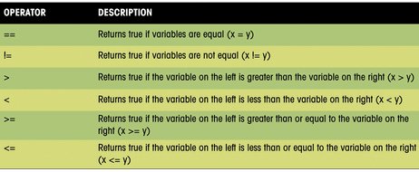
Logical Operators

